Slide 1
Mavlink

Slide 2
Communicating with your UAV

Slide 3

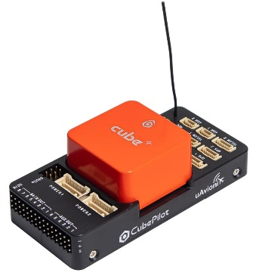
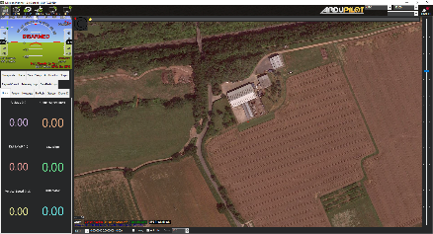
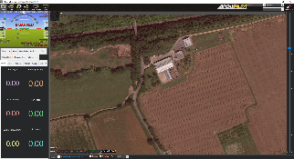

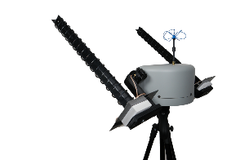

MAVLink
Open-source messaging protocol for drones
Use for telemetry and command
Communication with ground control stations such as Mission Planner
Wired or wireless connections
Talk mavlink in Python using Pymavlink
Pymavlink
Request and set parameters
Receive state information
Send servo control commands
Arm/disarm, change flight mode
Set waypoints
Everything you can do with MP
mavlink
mavlink
mavlink
mavlink
mavlink
mavlink
mavlink
mavlink
mavlink

Slide 4
Mavlink Ressources
PyMavlink examples and documentation
ArduSub book! ardusub.com/developers/pymavlink.html
Mavlink Documentation
https://mavlink.io/en/messages/common.html
Today’s presentation and scripts
https://github.com/meierkilian/ArdupilotIntro

Slide 5
Practicals

Slide 6
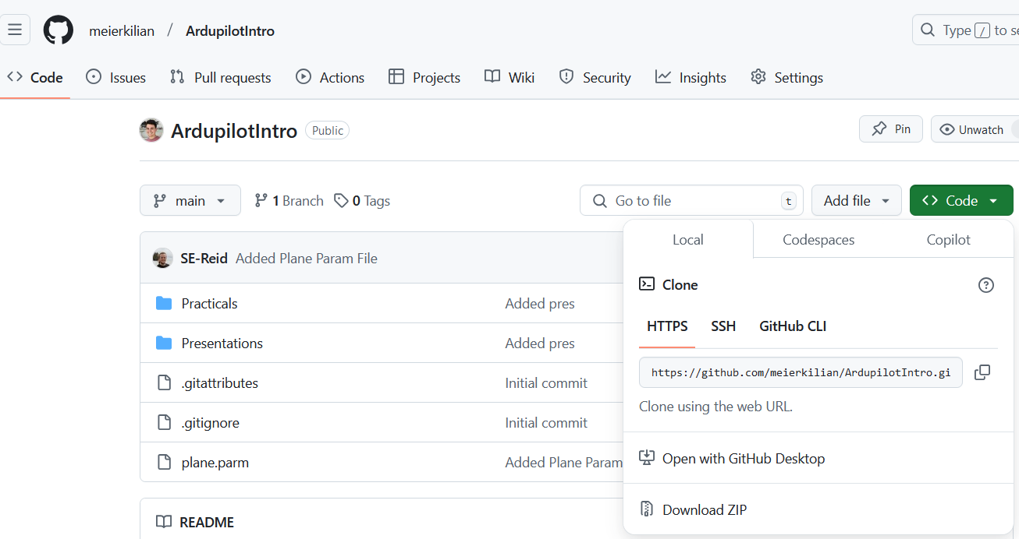
Download today’s scripts
https://github.com/meierkilian/ArdupilotIntro

Slide 7
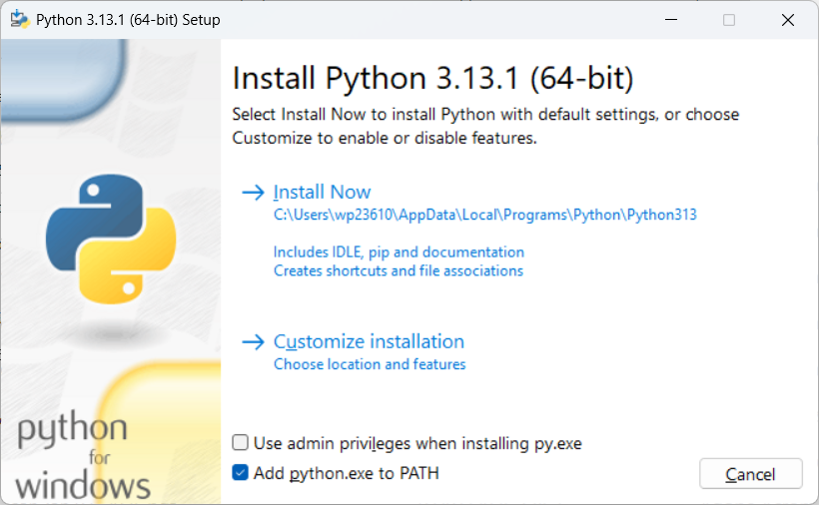
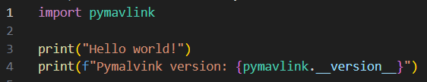
Installing python
Installing python
Download Python from: www.python.org/downloads/
Add python.exe to PATH
Run and click “Install now”
Installing Pymavlink
Open terminal (WIN+R, then type “cmd” and press Enter)
Run “pip install pymavlink”
Run “pip install requests”
Hello world script
Create a script “helloworld.py”
Run “python helloworld.py”

Slide 8
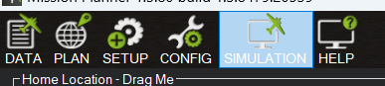
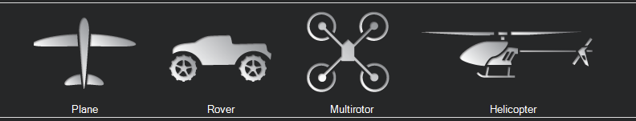
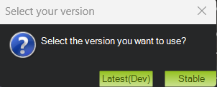
Start SITL

Slide 9
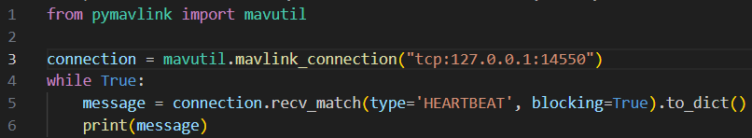
Task 1: connection and heartbeat
Start SITL
Create a quad copter
Ctrl + F, Mavlink, TCP Host, Write access, Connect
Connection
Depends on the scenario
connection = mavutil.mavlink_connection(‘tcp:127.0.0.1:14550’)
Heartbeat
message = connection.recv_match(type='HEARTBEAT', blocking=True).to_dict()
Waits for a message of type HEARTBEAT

Slide 10
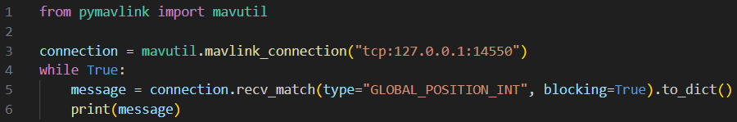
Task 2: get telemetry (or any message)
Have a look at common mavlink message and find a message that will give you the global position of the drone.
https://mavlink.io/en/messages/common.html

Slide 11
Task 3: taking-off
Taking-off includes three steps
Change the aircraft to the GUIDED mode
ARM the aircraft
Take-off
So three commands have to be sent!

Slide 12
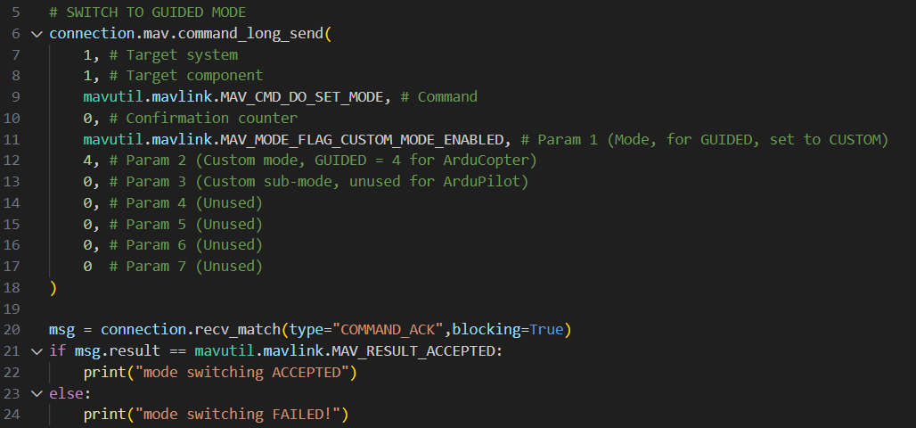
Task 3: taking-off: mode change

Slide 13
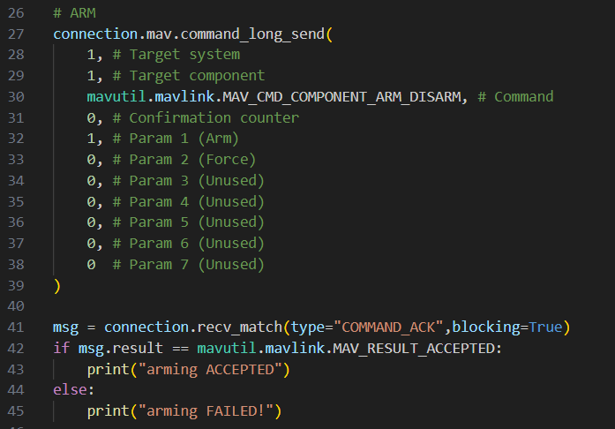
Task 3: taking-off: arming
Command name: MAV_CMD_COMPONENT_ARM_DISARM

Slide 14
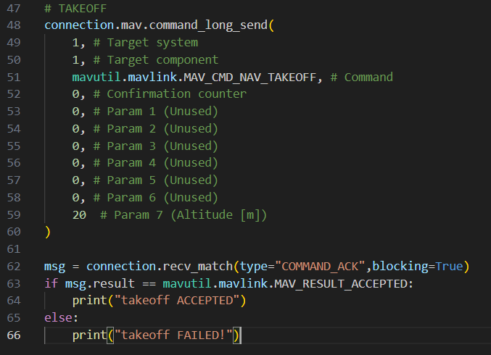
Task 3: taking-off: take-off
Command name: MAV_CMD_NAV_TAKEOFF

Slide 15
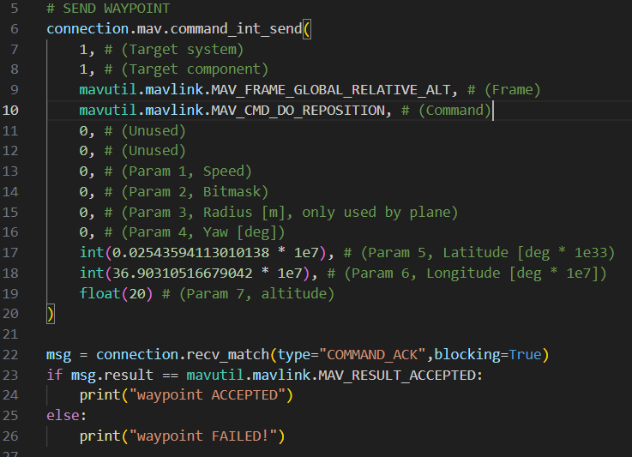
Task 4: send a waypoint command

Slide 16
Task 5: send a WP to remote SITL
Connect to local network
SSID: ANVLAN729
Password: ministrylevel369
Change connection to your groupe IP
Change the “target system” to your group ID

